Slide 1
Finite State Machines
Mor Vered, BIU University
Multi Robot Systems
Based on lectures by George Mason and CMU

Slide 2
Finite State Machine - Definition
FSA - Finite State Automation
Models of a behavior of a system or a complex object, with a limited number of defined conditions or modes.
Four Elements:
- States - define behavior and may produce actions.
- State Transitions - movement from one state to another.
- Rules/Conditions - must be met to allow a state transition.
- Input Events - Externally or internally generated, may possible trigger rules and lead to state transitions.

Slide 3
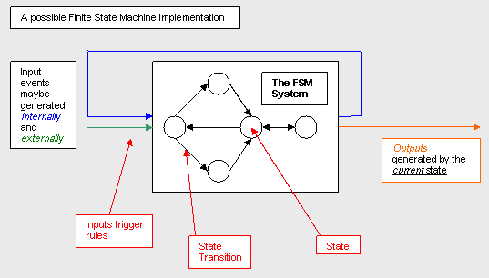
Finite State Machine - Definition
Initial state - provides a starting point.
Current state - remembers the product of the last state transition.

Slide 4
DFSM nonDFSM
FSM is typically used as a type of control system where knowledge is represented in the states, and actions are constrained by rules.
An adopted AI technique initially used for language representation.
Two main types of FSM.
Deterministic FSM, meaning that given an input and the current state, the state transition can be predicted.
Non-deterministic finite state machine. This is where given the current state; the state transition is not predictable. It may be the case that multiple inputs are received at various times, means the transition from the current state to another state cannot be known until the inputs are received (event driven).
Non deterministic FSM example : Use a random number generator to select a triggered rule. Adds unpredictability. ( Example : MoveUnit action may be both EvadeEnemy state and AttackEnemy state ). [ State may involve one or more actions ].

Slide 5
Fuzzy State Machines
In AI and computer games “a player feels like they are playing against a realistic simulation of intelligence, and not against a reproduction of a sequence of actions.”
The "sequence" which is one of the key benefits of FSM, should not be blindingly obvious in computer games. There are a number of extensions to FSM and workarounds for "mixing up" the sequence to make it harder to predict actions. One of these non-deterministic approaches involves the application of another proven artificial intelligence technique; Fuzzy Logic, called Fuzzy State Machines (FuSM).
A fuzzy value can be applied to various state transitions. When a conflict set is encountered the higher the fuzzy value for a transition, the higher the likelihood of the state transition.
An implementation of FuSM may involve the assignment of fuzzy values to various inputs to represent the degree an input is defined. The fuzzy system would use these weighted input values in the evaluation of rules, triggering only state transitions whose assessed value is above a specified threshold.

Slide 6
Representing a Finite State Machine
It can be represented using a state transition table which shows the current state, input, any outputs, and the next state.
Input Current State | Input₀ Input₁ …. Input_{n}
State₀ State₁ …. State_{n} | Next State / Output …. Next State / Output …. …. …. …. …. …. …. …. ….

Slide 7
Representing a Finite State Machine
It can also be represented using a state diagram which has the same information as the state transition diagram.
Input / Output
State₀
State₁
Input / Output

Slide 8
State Machines: Definition of Terms
State Diagram
  Illustrates the form and function of a state machine. Usually drawn as a bubble-and-arrow diagram.
State
  A uniquely identifiable set of values measured at various points in a digital system.
Next State
  The state to which the state machine makes the next transition, determined by the inputs present when the device is clocked.
Branch
  A change from present state to next state.
Mealy Machine
  A state machine that determines its outputs from the present state and from the inputs.
Moore Machine
  A state machine that determines its outputs from the present state only.

Slide 9
Present State and Next State
State 4
For any given state, there is a finite number of possible next states. On each clock cycle, the state machine branches to the next state. One of the possible next states becomes the new present state, depending on the inputs present on the clock cycle.
State 5
State 6
State 7
On a well-drawn state diagram, all possible transitions will be visible, including loops back to the same state. From this diagram it can be deduced that if the present state is State 5, then the previous state was either State 4 or 5 and the next state must be either 5, 6, or 7.

Slide 10
Moore and Mealy Machines
Both these machine types follow the basic characteristics of state machines, but differ in the way that outputs are generated.
Moore Machine:
  Outputs are independent of the inputs, ie outputs are effectively produced from within the state of the state machine.
Mealy Machine:
  Outputs can be determined by the present state alone, or by the present state and the present inputs, ie outputs are produced as the machine makes a transition from one state to another.

Slide 11
Moore Machine Diagrams
The Moore State Machine
output is shown inside the
state bubble, because the
output remains the same as
long as the state machine
remains in that state.
The output can be arbitrarily
complex but must be the
same every time the
machine enters that
state.
State 1
q,r
a,b
Input condition that
must exist in order
to execute these
transitions from
State 1
i,j
Output condition that
results from being in
a particular present
state
State 2
x,y

Slide 12
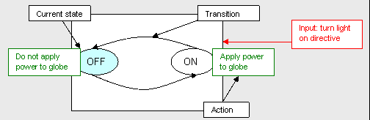
Moore Machine Diagrams
Outputs are generated as products
of the states.
In this example the states define
what to do ; such as apply power
to the light globe.

Slide 13
Mealy Machine Diagrams
The Mealy State Machine generates outputs based on:
The Present State, and
The Inputs to the M/c.
So, it is capable of generating many different patterns of output signals for the same state, depending on the inputs present on the clock cycle.
Outputs are shown on transitions since they are determined in the same way as is the next state.
State 1
a,b
q,r
Input condition that
must exist in order
to execute these
transitions from
State 1
i,j
x,y
Output condition that
results from being in
a particular present
state
State 2

Slide 14
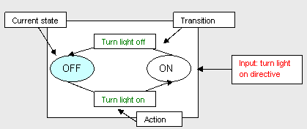
Mealy Machine Diagrams
Outputs are generated as products of
the transitions between states. In example the light is affected by the process of changing states.

Slide 15
Moore vs. Mealy FSM (1)
Moore and Mealy FSMs Can Be Functionally Equivalent
Mealy FSM Has Richer Description and Usually Requires Smaller Number of States
  Smaller circuit area

Slide 16
Moore vs. Mealy FSM (2)
Mealy FSM Computes Outputs as soon as Inputs Change
  Mealy FSM responds one clock cycle sooner than equivalent Moore FSM
Moore FSM Has No Combinational Path Between Inputs and Outputs
  Moore FSM is less likely to have a shorter critical path

Slide 17
FSM Advantages
Simple
Predictable ( deterministic FSM ) - given a set of inputs and a known current state, the state transition can be predicted, allowing for easy testing.
Due to their simplicity, FSMs are quick to design, quick to implement and quick in execution.
FSM is an old knowledge representation and system modeling technique, and its been around for a long time, as such it is well proven even as an artificial intelligence technique, with lots of examples to learn from.
Easy to transfer from a meaningful abstract representation to a coded implementation.

Slide 18
FSM Disadvantages
The predictable nature of deterministic FSMs can be unwanted in some domains such as computer games (non-DFSM tries to solve this).
The conditions for state transitions are ridged, meaning they are fixed.
Not suited to all problem domains, should only be used when a systems behavior can be decomposed into separate states with well defined conditions for state transitions. This means that all states, transitions and conditions need to be known up front and be well defined !!

Slide 19
Example: Vending Machine
Takes only quarters and dollar bills
Won't hold more than $1.00
Sodas cost $.75
Possible actions (inputs)
  deposit $.25 (25)
  deposit $1.00 ($)
  push button to get soda (soda)
  push button to get money returned (ret)

Slide 20
Classic Example: Vending Machine
State: description of the internal settings of the machine, e.g. how much money has been depositied and not spent
Finite states: 0, 25, 50, 75, 100,
Rules: determine how inputs can change state

Slide 21
Example: Vending Machine
25
25
50
001
010
25
25
ret
ret
soda
soda
75
0
000
ret
011
100
ret
25
Inputs
25 = 00
100 = 01
soda = 10
ret = 11
100
100

Slide 22
AI Example: Computer Game
The goal : to use a computer game to illustrate the conceptual workings of a FSM based on a practical rather than theoretical implementation.
First person computer game called Quake, under GNU General Public License.
Quake makes extensive use of FSMs as a control mechanism governing the entities that exist in the game world.
Quake is a good example, and a good learning tool that can show the power of both very simple finite state machines such as the rocket, and slightly more complex FSM made up of a hierarchy of FSM and motivated by goals, such as the Shambler monster.

Slide 23
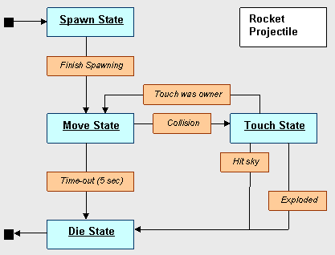
Quake Computer Game
A rocket in Quake is fired from the Rocket Launcher weapon which may be possessed and operated by a human player.
Full life cycle of a rocket from Quake:
Blue : states.
Orange : triggers.
Black : Entry and
exit point.
Arrows : state
transitions.

Slide 24
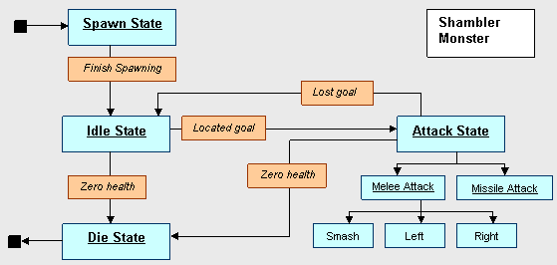
Quake Computer Game - layered/heirarchical FSM
A Shambler is a big bad monster entity from the single player component of Quake. Its mission in life is to kill the player, once it is aware of the player.
Full life cycle of a shambler monster from Quake:
Blue : states.
Orange : triggers.
Black : Entry and
exit point.
Arrows : state
transitions.
Example of sub states : the monster can only perform one attack per execution of the attack state. Melee - close, Missile - far. Depends on inputs. Use random number in melee to add unpredictability.

Slide 25
Summary
Defenition of finite state machine, learning that it can be used as a control technique for a system, describing states or behaviors of that system, and defining rules or conditions that govern transitions from the systems current state to another state.
An FSM is considered to be deterministic which means its actions are easily predictable. Extensions to finite state machines such as random selection of transitions, and fuzzy state machines shows us another type of FSM called non-determinist where the systems actions were not as predictable, giving a better appearance of intelligence.

Slide 26
Summary
Next we took a close look at a simple real world implementation and learned how a rocket could be modeled using FSM. This lead us to a more advanced example where we saw the behavior of a semi-intelligent monster modeled using a combination of hierarchical finite state machines and the use of goals as a primary motivator.
Finite state machines are a simple and effective artificial intelligence technique for controlling a system and providing the appearance of intelligence. In some cases the perceived appearance of intelligence is more important than actual intelligence, and that FSMs are able to provide this perception.

Slide 27
Relevant Links and Information
Quake, a computer game by id Software, website: http://www.idsoftware.com/games/quake/quake/
GNU General Public License (GPL): http://www.gnu.org/copyleft/gpl.html
Quake source code released under the GPL, links for engine and game code:
Engine Code:
ftp://ftp.idsoftware.com/idstuff/source/q1source.zip
Game & Tool Code:
ftp://ftp.idsoftware.com/idstuff/source/q1tools_gpl.tgz

Slide 28
Questions?

